Slide 1





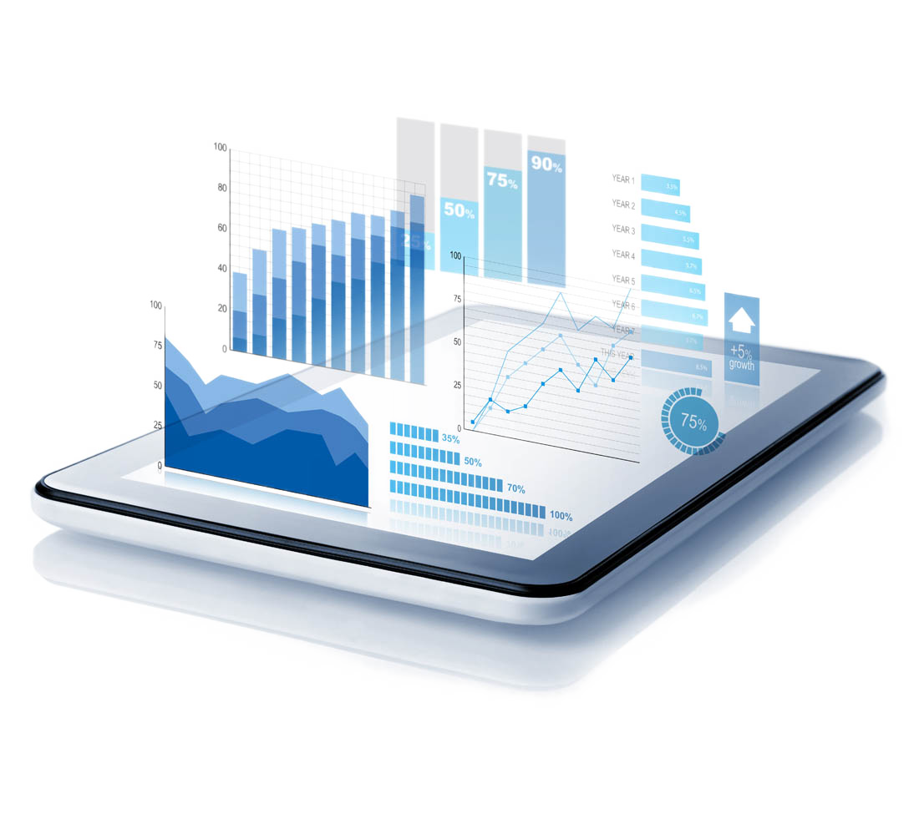


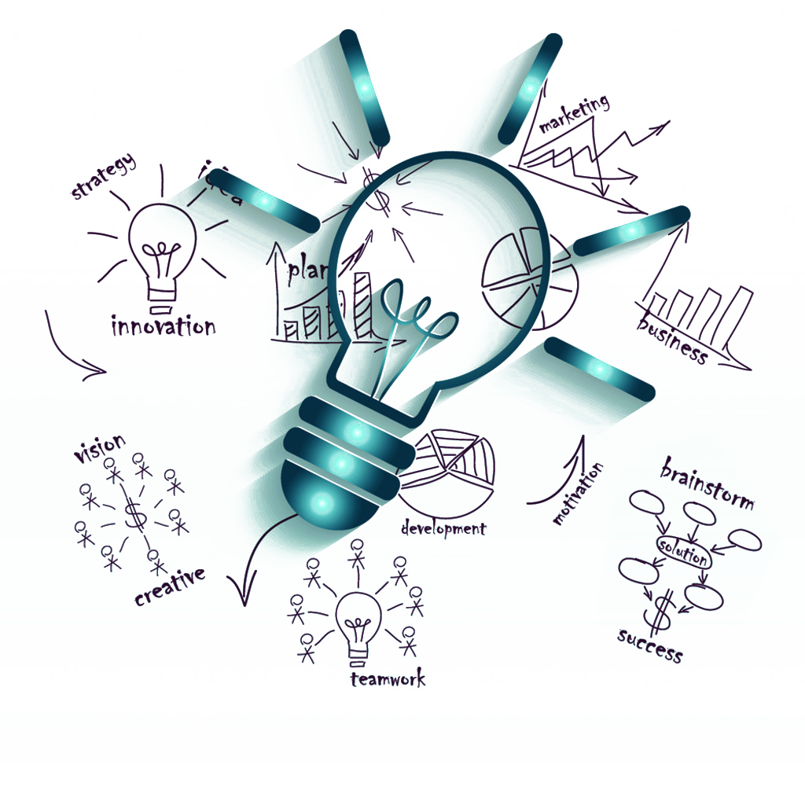




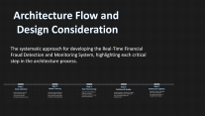




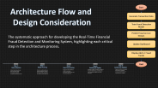











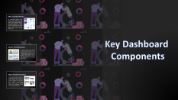



Real time transaction monitoring dashboard
An advanced system leveraging machine learning for the identification of fraudulent financial activities and real-time monitoring using a dynamic user interface.

Slide 2
Payments and digital channels
Real-Time Transaction Monitoring Dashboard
Safeguarding Financial Transactions in Real-Time
Designed to identify and monitor fraudulent activities as they occur
Powered by advanced machine learning techniques
Features a user-friendly dashboard for real-time analytics
Ensures security, transparency, and trust in financial operations
Presented by
Sarvesh Raju B
Kavya R Naik
Shivani B
Spoorthi C
Prasad R K

Slide 3

INTRODUCTION
The Real-Time Financial Fraud Detection and Monitoring System is designed to safeguard financial transactions by identifying and monitoring fraudulent activities as they occur. This innovative system leverages advanced machine learning techniques and provides a user- friendly dashboard for real-time analytics, ensuring security and trust in financial operations.

Slide 4

Problem
Statement

Slide 5
Problem
Statement
The financial sector faces significant challenges with the rising incidence of fraud, leading to substantial losses for both institutions and customers. This project aims to address these challenges by creating a system capable of identifying and monitoring fraudulent transactions as they occur, ensuring timely interventions and enhanced security.

Slide 6
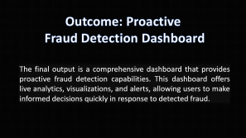
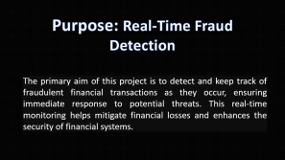

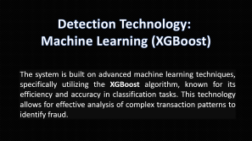

Project
Overview

Slide 7
Purpose: Real-Time Fraud
Detection
The primary aim of this project is to detect and keep track of fraudulent financial transactions as they occur, ensuring immediate response to potential threats. This real-time monitoring helps mitigate financial losses and enhances the security of financial systems.

Slide 8
Detection Technology:
Machine Learning (XGBoost)
The system is built on advanced machine learning techniques, specifically utilizing the XGBoost algorithm, known for its efficiency and accuracy in classification tasks. This technology allows for effective analysis of complex transaction patterns to identify fraud.

Slide 9
Outcome: Proactive
Fraud Detection Dashboard
The final output is a comprehensive dashboard that provides proactive fraud detection capabilities. This dashboard offers live analytics, visualizations, and alerts, allowing users to make informed decisions quickly in response to detected fraud.

Slide 10
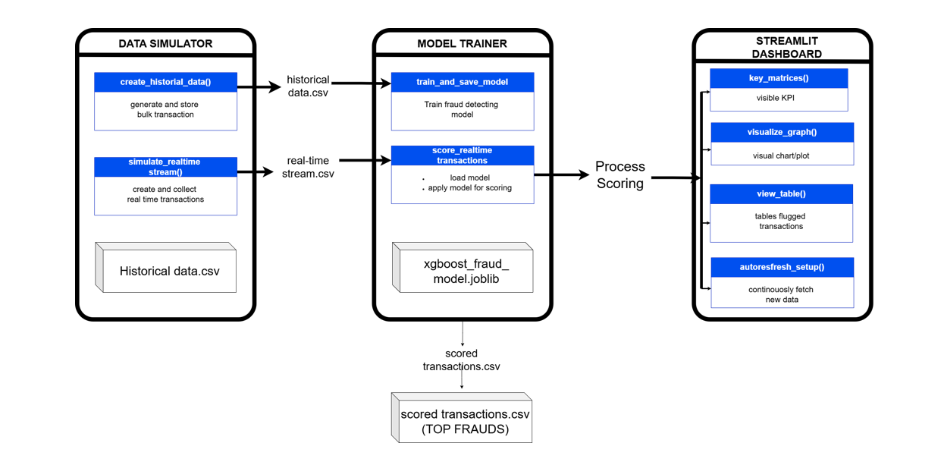
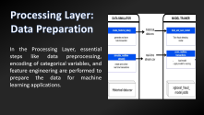
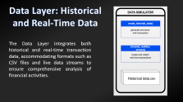
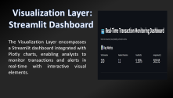
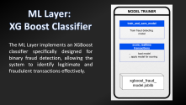

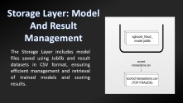
System
Architecture

Slide 11
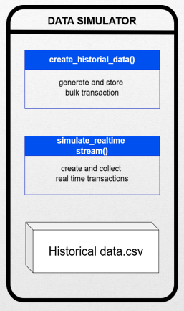
Data Layer: Historical and Real-Time Data
The Data Layer integrates both historical and real-time transaction data, accommodating formats such as CSV files and live data streams to ensure comprehensive analysis of financial activities.

Slide 12
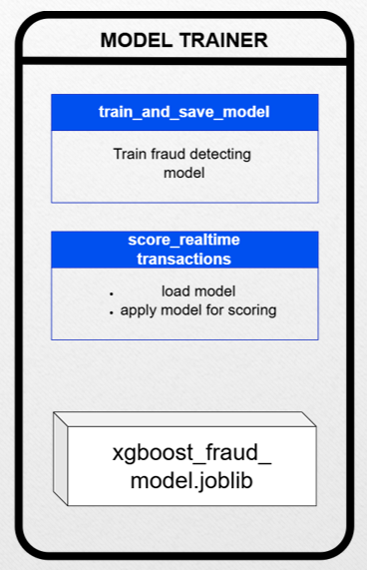
ML Layer:
XG Boost Classifier
The ML Layer implements an XGBoost classifier specifically designed for binary fraud detection, allowing the system to identify legitimate and fraudulent transactions effectively.

Slide 13
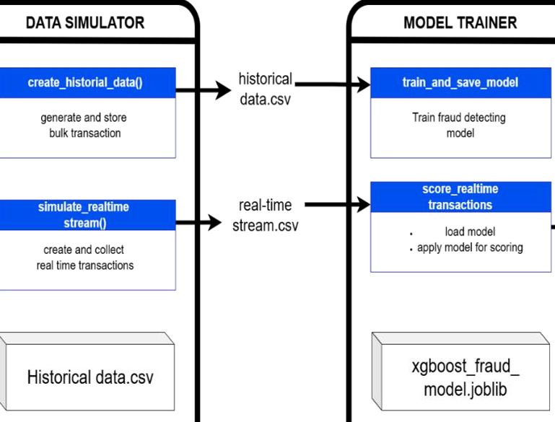
Processing Layer:
Data Preparation
In the Processing Layer, essential steps like data preprocessing, encoding of categorical variables, and feature engineering are performed to prepare the data for machine learning applications.

Slide 14
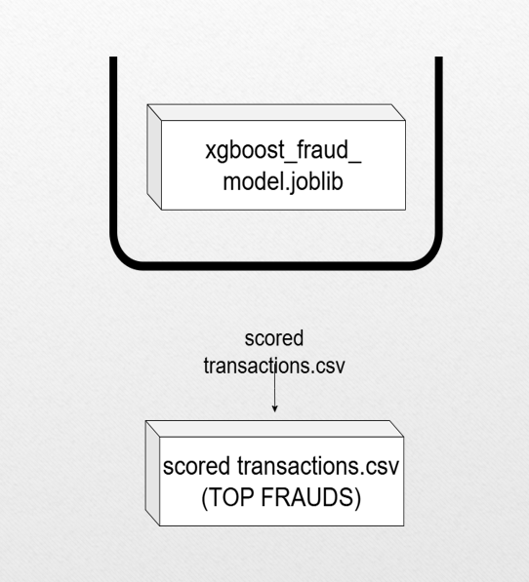
Storage Layer: Model
And Result Management
The Storage Layer includes model files saved using Joblib and result datasets in CSV format, ensuring efficient management and retrieval of trained models and scoring results.

Slide 15
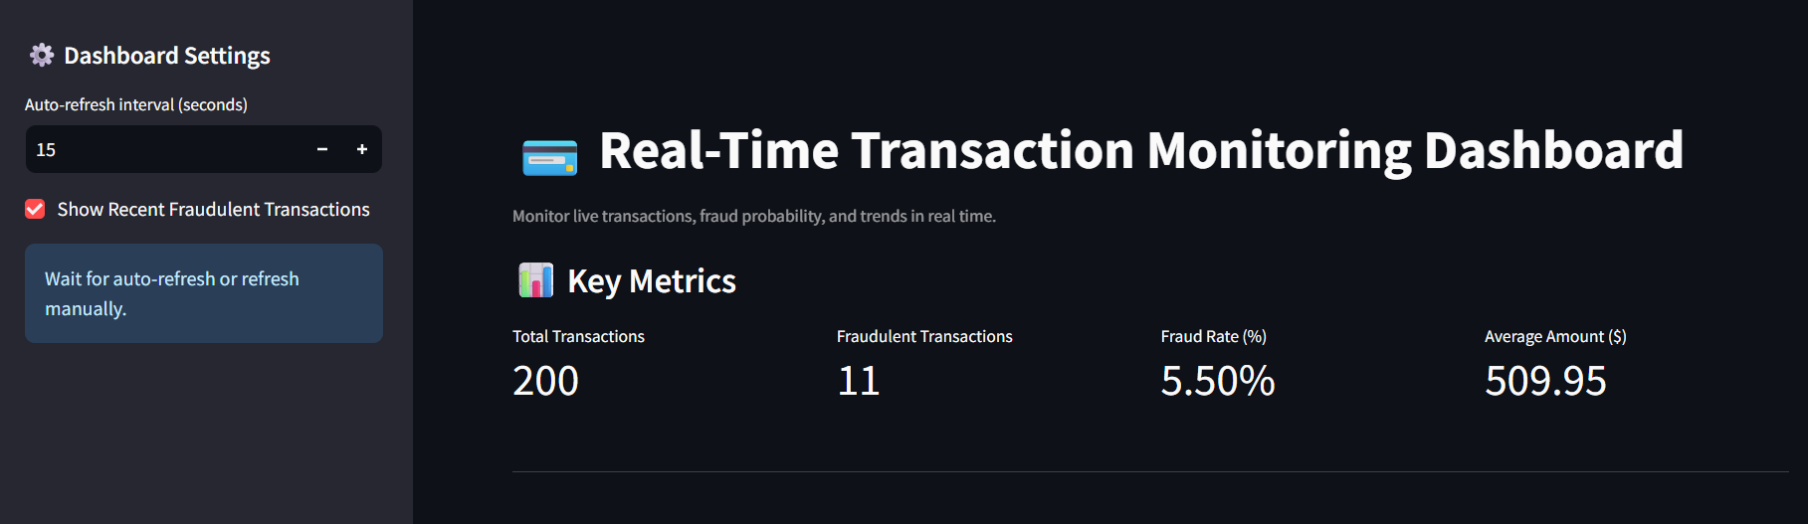
Visualization Layer:
Streamlit Dashboard
The Visualization Layer encompasses a Streamlit dashboard integrated with Plotly charts, enabling analysts to monitor transactions and alerts in real-time with interactive visual elements.

Slide 16
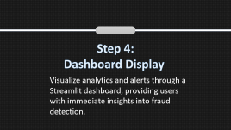
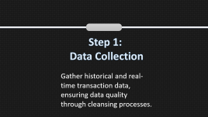
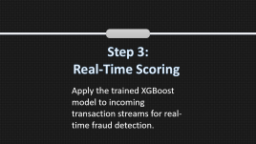
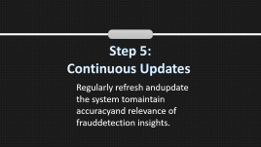
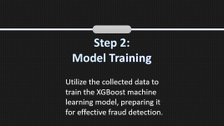
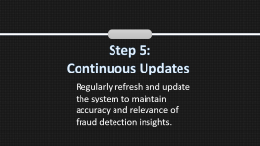
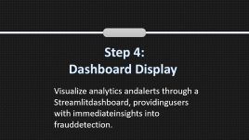
Architecture Flow and
Design Consideration
The systematic approach for developing the Real-Time Financial Fraud Detection and Monitoring System, highlighting each critical step in the architecture process.

Slide 17
Step 1:
Data Collection
Gather historical and real-time transaction data, ensuring data quality through cleansing processes.

Slide 18
Step 2:
Model Training
Utilize the collected data to train the XGBoost machine learning model, preparing it for effective fraud detection.

Slide 19
Step 3:
Real-Time Scoring
Apply the trained XGBoost model to incoming transaction streams for real-time fraud detection.

Slide 20
Step 4:
Dashboard Display
Visualize analytics and alerts through a Streamlit dashboard, providing users with immediate insights into fraud detection.

Slide 21
Step 5:
Continuous Updates
Regularly refresh and update the system to maintain accuracy and relevance of fraud detection insights.

Slide 22
Architecture Flow and
Design Consideration
Start
Generate Transaction Data
Train Fraud Detection Model
Predict Fraud on Live Stream
The systematic approach for developing the Real-Time Financial Fraud Detection and Monitoring System, highlighting each critical step in the architecture process.
Update Dashboard
Display Alerts / Fraud Trends
End

Slide 23







Programming Language : Python
Data Libraries : Pandas, NumPy, Scikit-learn
Machine Learning Library : XGBoost
Visualization : Plotly, Streamlit
Deployment: Cloud , Docker, Streamlit Web
Data Formats : CSV, Joblib
Technology stack

Slide 24





Design Considerations
Modular structure enhances maintainability
Fault tolerance ensures system reliability
Secure data handling is crucial
Extendable to Apis for flexibility

Slide 25

Module
Walkthrough
Overview

Slide 26

Model Training –
Leverage Historical Data
The model training process involves using a historical dataset to build a robust machine learning model. This includes data preprocessing, feature engineering, and the training of the model using the XGBoost algorithm to accurately predict fraudulent transactions.

Slide 27

Real-Time Scoring -Immediate Fraud Detection
Real-time scoring applies the trained model to live transaction data, enabling immediate fraud detection. This involves ingesting new data, predicting fraud probabilities, and classifying transactions as legitimate or fraudulent in real-time.

Slide 28
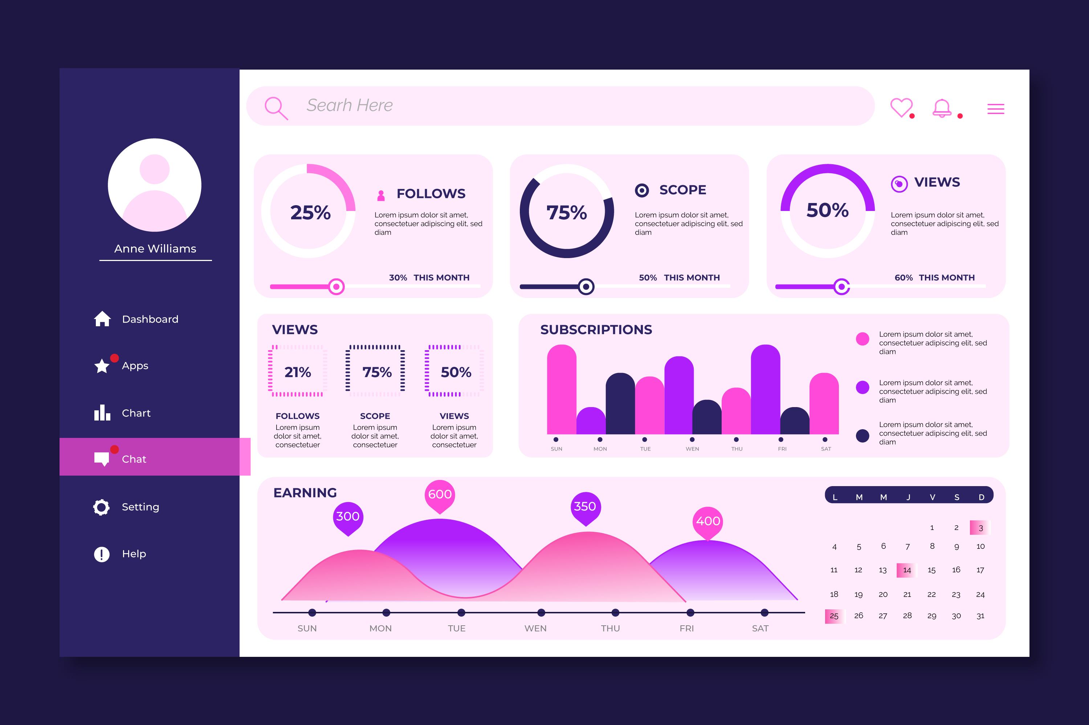
Visualization Dashboard-Interactive Monitoring
The visualization dashboard provides an interactive and user-friendly interface for monitoring fraud activities. It displays live metrics, alerts, and analytics, allowing users to quickly assess and respond to potential fraud cases.

Slide 29

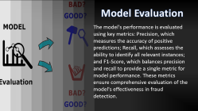
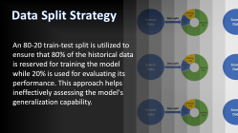
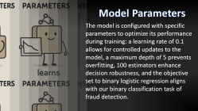
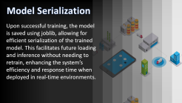

Model Training and Evaluation

Slide 30
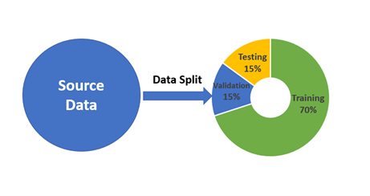
Data Split Strategy
An 80-20 train-test split is utilized to ensure that 80% of the historical data is reserved for training the model while 20% is used for evaluating its performance. This approach helps ineffectively assessing the model's generalization capability.

Slide 31
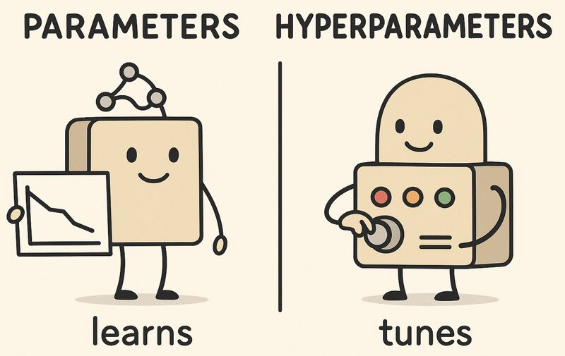
Model Parameters
The model is configured with specific parameters to optimize its performance during training: a learning rate of 0.1 allows for controlled updates to the model, a maximum depth of 5 prevents overfitting, 100 estimators enhance decision robustness, and the objective set to binary logistic regression aligns with our binary classification task of fraud detection.

Slide 32
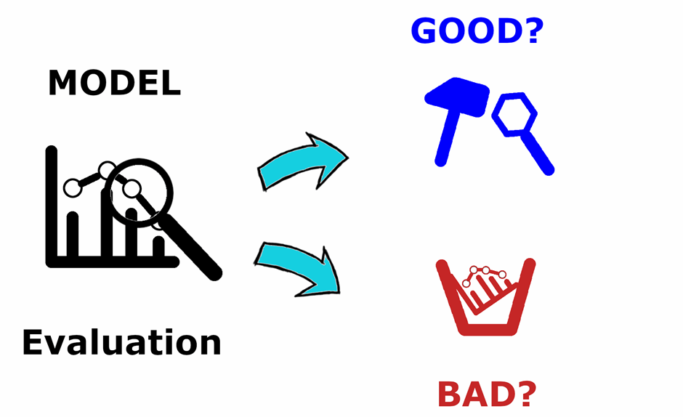
Model Evaluation
The model's performance is evaluated using key metrics: Precision, which measures the accuracy of positive predictions; Recall, which assesses the ability to identify all relevant instances; and F1-Score, which balances precision and recall to provide a single metric for model performance. These metrics ensure comprehensive evaluation of the model's effectiveness in fraud detection.

Slide 33
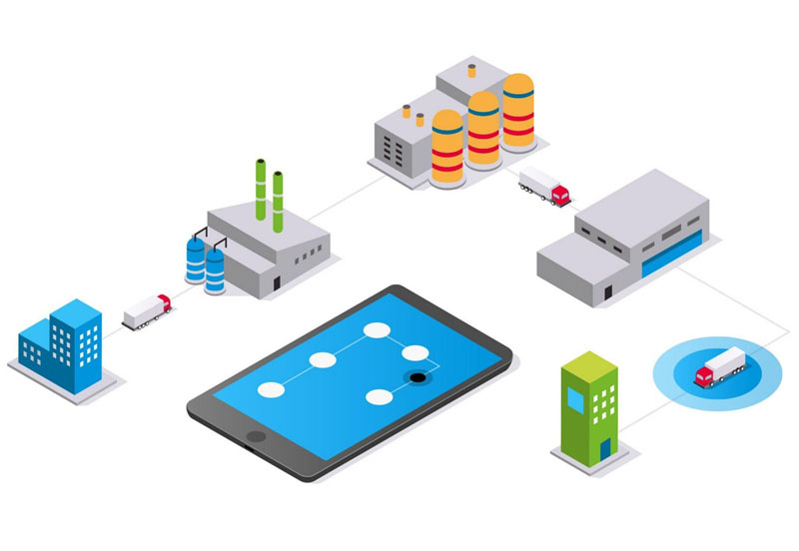
Model Serialization
Upon successful training, the model is saved using joblib, allowing for efficient serialization of the trained model. This facilitates future loading and inference without needing to retrain, enhancing the system’s efficiency and response time when deployed in real-time environments.

Slide 34
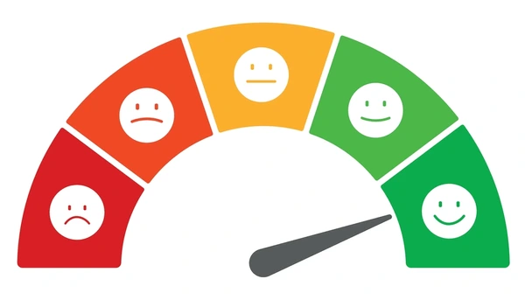
Real Time scoring
Overview
The Real-Time Scoring component is essential for operationalizing the trained XGBoost model. It continuously ingests live transaction data, calculates the probability of fraud, and classifies transactions as fraudulent or legitimate. The results are then exported for further analysis and monitoring through the dashboard.

Slide 35
Key Outputs
Essential metrics and results from the fraud detection system.
2%
Fraud Rate Percentage
150
Detected Frauds
Top 5 Suspicious Transactions:
Transaction ID: 12345 Transaction ID: 67890 Transaction ID: 11223 Transaction ID: 44556 Transaction ID: 77889
Ranked List of Top Suspicious Transactions
dashboard_data.csv
Export File

Slide 36
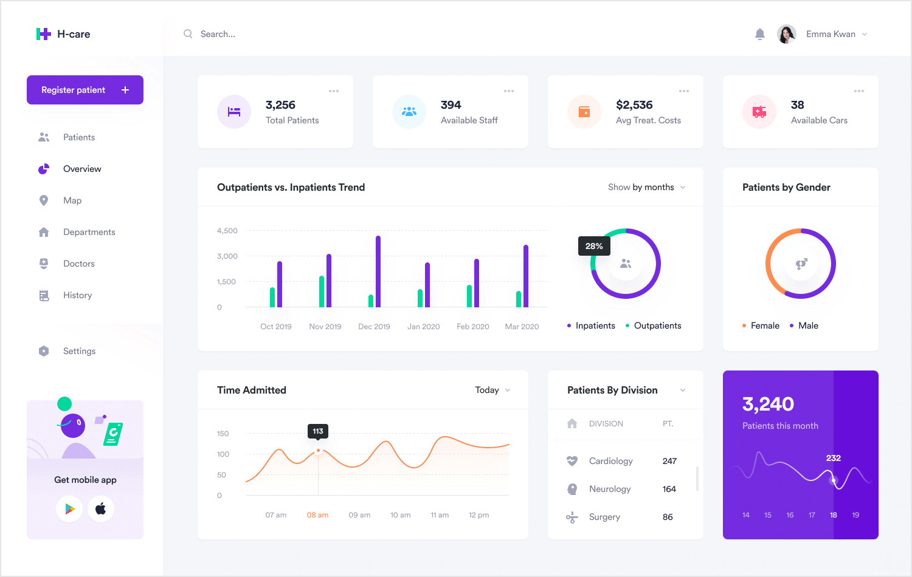
Dashboard Visualization
Overview
The dashboard is developed using the Streamlit framework, which allows for rapid deployment and easy user interaction. It features live metrics and auto-refresh capabilities every 5-15 seconds, ensuring analysts have the most up-to-date information at their fingertips. Additionally, Plotly is employed for creating interactive visualizations, enhancing the user experience and enabling deeper insights into fraud trends and transaction behaviors.

Slide 37
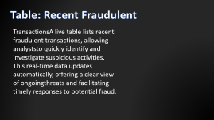
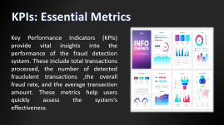
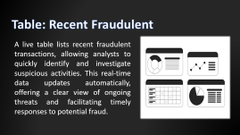

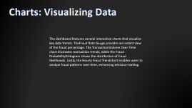
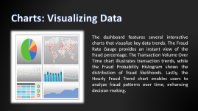
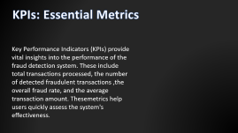
Key Dashboard
Components

Slide 38
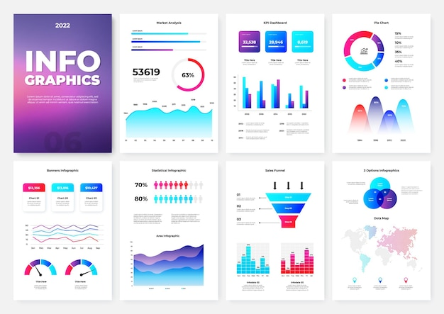
KPIs: Essential Metrics
Key Performance Indicators (KPIs) provide vital insights into the performance of the fraud detection system. These include total transactions processed, the number of detected fraudulent transactions ,the overall fraud rate, and the average transaction amount. These metrics help users quickly assess the system's effectiveness.

Slide 39
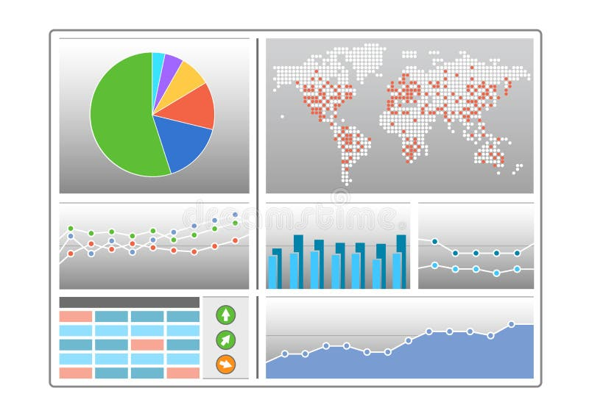
Charts: Visualizing Data
The dashboard features several interactive charts that visualize key data trends. The Fraud Rate Gauge provides an instant view of the fraud percentage. The Transaction Volume Over Time chart illustrates transaction trends, while the Fraud Probability Histogram shows the distribution of fraud likelihoods. Lastly, the Hourly Fraud Trend chart enables users to analyze fraud patterns over time, enhancing decision-making.

Slide 40

Table: Recent Fraudulent
A live table lists recent fraudulent transactions, allowing analysts to quickly identify and investigate suspicious activities. This real-time data updates automatically, offering a clear view of ongoing threats and facilitating timely responses to potential fraud.

Slide 41



Dashboard Features
Automatic data refresh intervals
Real-time anomaly detection
Supports simulated and live data
User-friendly web UI

Slide 42

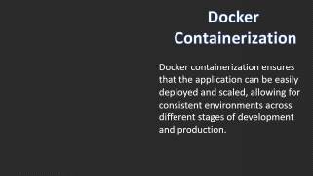
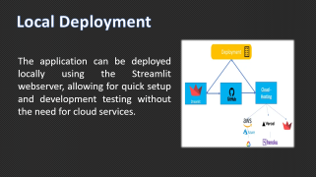
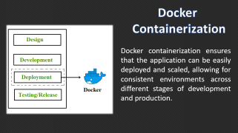

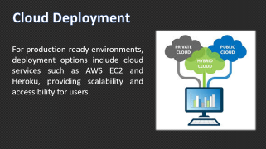
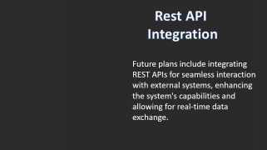


Deployment Overview

Slide 43

Local Deployment
The application can be deployed locally using the Streamlit webserver, allowing for quick setup and development testing without the need for cloud services.

Slide 44

Cloud Deployment
For production-ready environments, deployment options include cloud services such as AWS EC2 and Heroku, providing scalability and accessibility for users.

Slide 45

Docker
Containerization
Docker containerization ensures that the application can be easily deployed and scaled, allowing for consistent environments across different stages of development and production.

Slide 46

Rest API
Integration
Future plans include integrating REST APIs for seamless interaction with external systems, enhancing the system's capabilities and allowing for real-time data exchange.

Slide 47






Support for high transaction volumes
Ability to add new features
Scaling up for demand
Integration with diverse systems
Cost-effective scaling solutions
Scalability Consideration

Slide 48
Conclusion and Future Scope
The project successfully delivers a robust end-to-end fraud detection system, integrating machine learning for predictive analysis with a user-friendly live dashboard. This system not only exhibits high accuracy and responsiveness but is also designed for seamless integration into enterprise financial infrastructures, paving the way for enhanced security and operational efficiency.

Slide 49








Challenges and Learning

Slide 50
Handling Imbalanced Datasets
One of the significant challenges faced was the handling of highly imbalanced datasets, where fraudulent transactions represented a small percentage of the total data. This necessitated the implementation of techniques such as oversampling and under-sampling in the XGBoost model to improve detection rates.

Slide 51
Synchronizing Dashboard Refresh
Synchronizing real-time dashboard refresh posed another challenge, as it required ensuring that the analytics presented to users were always up-to-date. This involved optimizing the data flow and refreshing intervals without compromising performance, thus maintaining a seamless user experience.

Slide 52
Understanding ML Pipelines
Through the project, there was a significant improvement in understanding machine learning pipelines, including data preprocessing, model training, and evaluation techniques. This knowledge is crucial for future projects involving predictive analytics.

Slide 53
Experience with Deployment Tools
The project also provided valuable experience with deployment tools and visualization frameworks like Streamlit and Plotly. This hands-on experience is beneficial for effectively presenting data insights and building interactive applications in future endeavors.

Slide 54












Real time transaction monitoring dashboard
An advanced system leveraging machine learning for the identification of fraudulent financial activities and real-time monitoring using a dynamic user interface.

Slide 55


Any Questions?

